Slide 1
General Principles of Conduct and Action
In collaboration
with

Slide 2
03
Introduction
06
General Principles of Conduct and Action
07
Care and Respect for People
23
Continuous Development and Optimization
CONTENTS
39
Effective Safety Culture
54
Assessment and Verification
58
Annual Self Assessment And Improvement Cycle
60
Periodic Third Party Assessment and Verification
69
Continuous Performance Improvement Monitoring
70
Conclusion

Slide 3
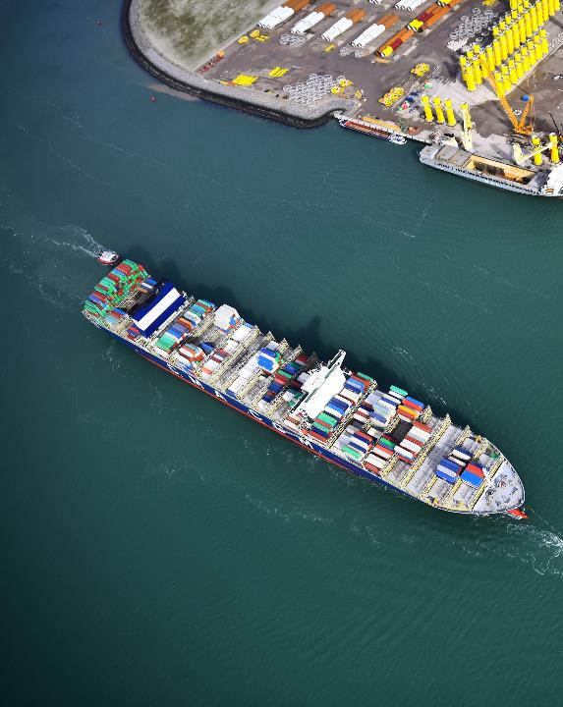
INTRODUCTION
InterManager is regarded as one of Shipping’s most influential trade associations that has successfully helped shape the industry over the years.
Our primary aim is to continuously improve Ship Management Industry’s standards and we are dedicated to assist all members differentiate from the rest of the industry, set the standard and assure their optimum quality of operation and service.
Loyal to this mission, InterManager gave written expression to its General Principles of Conduct and Action in order to reinforce their communication and implementation throughout the Association worldwide.
These principles guided successfully our activities over the past 30 years and can now provide the framework for establishing a common “modus operandi” among members in order to facilitate a culture of integrity, care, professional commitment, respect for others, efficiency and accountability.
InterManager’s General Principles of Conduct and Action also act as a guide dedicated to raising awareness on areas involving ethical risk and discouraging unethical conduct.
We anticipate that, through their live and dynamic nature, our principles will systematically be guiding our members in an everchanging world and ensuring that they achieve a minimum of prerequisites.
03

Slide 4
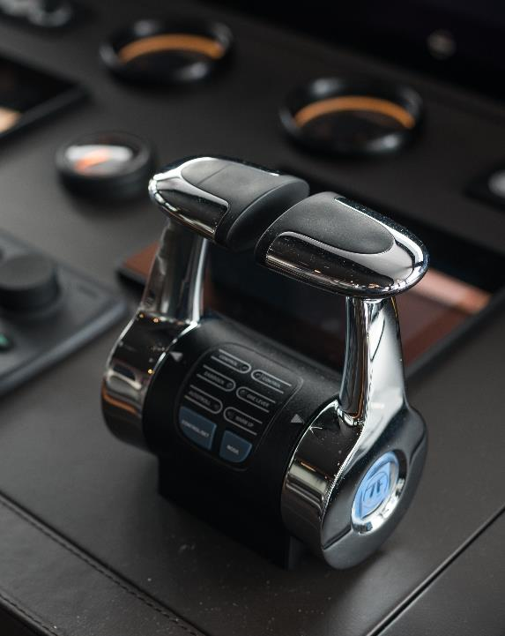
HOW IT WORKS
The Shipping industry undergoes and will undergo dramatic changes in the future and InterManager considers that success comes through adaptability. Thus, members are expected to be progressive and constantly mobilized towards change and innovation.
Unity is strength, and members are furthermore presumed to be part of a culture where willingness to improve and sharing of knowledge and best practices with each other lays within its core.
Committed to protecting and preparing future generations, they should act proactively and collectively towards shaping a sustainable future for the industry and the community.
To accommodate these expectations, the new General Principles of Conduct and Action take on board the essential parts of InterManager’s existing DNA. Its aim is to:
Ensure commitment to safety, environmental protection and sustainable operations by everyone (members, associates and third-parties) related to the Association.
Continuously improve professional and ethical standards internally for members and externally for partners.
Mobilize members so they are not simply “passengers” but active ambassadors of progress on all levels.

Slide 5
HOW IT WORKS
InterManager’s General Principles of Conduct and Action are not intended to be exhaustive and static, but rather aim to address the essential areas of focus and be adaptable.
They may be further complemented in the future by more specific requirements and prerequisites having regard to current conditions, particular industry demands and social changes, but in any case, without detracting from the core of the general principles.
The purpose of this document is to make a public statement of the Association’s adherence to the General Principles of Conduct and Action, which applies to all InterManager Members and constitutes a requirement for belonging to InterManager.

Slide 6
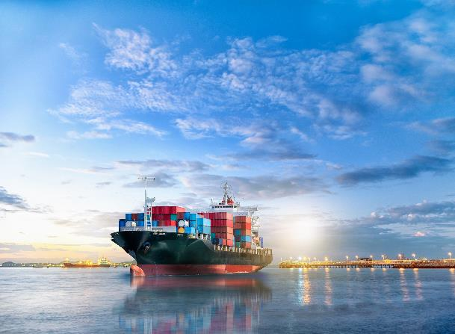
GENERAL PRINCIPLES OF CONDUCT AND ACTION
06

Slide 7
CARE AND RESPECT FOR PEOPLE
Diversity, Inclusion and Equal Opportunities
Bullying and Harassment
Stakeholders’ Health and Wellbeing
Social Responsibility
Partnership
07

Slide 8
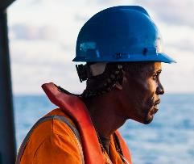
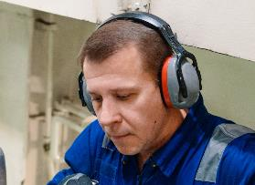
CARE AND RESPECT FOR PEOPLE
Diversity, Inclusion and Equal Opportunities
Unity in diversity towards excellence
All InterManager members are committed to Diversity, Inclusion and Equal Opportunities and ensure fair treatment and equal opportunities for all.
We aim to eradicate prejudice and discrimination in Shipping on the basis of individual or group’s protected characteristics such as:
Race
Gender
Age
Religion/belief
Sexual orientation
Pregnancy
Disability
We acknowledge that unity in Diversity outperforms unity in similarities and thus recognise, respect each other's differences and embrace a diverse environment with a wide range of backgrounds and mindsets.
By promoting inclusion, we create an environment where everyone feels welcomed and valued.
Through continuous training we raise our awareness of our unconscious biases and learn how to manage them.
Equal opportunities mean fairness at its core: we ensure that individuals, or groups, are not treated less favourably because of their protected characteristics.
We protect the disadvantaged and provide the tools they need to access the same, fair opportunities as the rest of their peers.
We are vigilant and DO NOT tolerate any form of discrimination on our watch.

Slide 9
CARE AND RESPECT FOR PEOPLE
Diversity, Inclusion and Equal Opportunities
Expected Behaviours/KPIs
Code of Conduct including Diversity, Inclusion and Equal Opportunities valuing Shore and Seagoing personnel by respecting their human rights, complying with the MLC and all applicable legislation.
01
Management system, supported by appropriate staffing and procedures, to promote Diversity, Inclusion and Equal Opportunities and manage compliance with MLC.
02
Code of Conduct including Diversity, Inclusion and Equal Opportunities, relevant guidelines (Dos and Don’ts) and practical resources are provided as part of the onboarding process to newcomers.
03
Mandatory cultural awareness, diversity and inclusion, emotional intelligence, social dynamics training and mentoring plan is available for Shore and Seagoing personnel aiming to facilitate cultural competencies.
04
An environment where personnel is informed, involved and able to exercise their rights through regular communication of their rights and obligations in relation to Diversity, Inclusion and Equal Opportunities is cultivated.
05
“Declaration of employees/seafarers’ rights” included to employment contracts which must be signed as “read and acknowledged” by the newcomer.
06
07
Anti-discrimination enforcement: Zero tolerance to discrimination verified by internal audits, surveys, visits, whistleblowing, disciplinary actions and ensured confidentiality.

Slide 10
CARE AND RESPECT FOR PEOPLE
Diversity, Inclusion and Equal Opportunities
Expected Behaviours/KPIs
Recruitment, promotion and career development are based on merit (qualifications, skills, talent, motivation, potential, fit for duty, etc.) regardless of any protected characteristic or relationship.
08
Shore and Seagoing personnel’s career and promotion support is provided through identification of individual training for the development of the necessary technical and behavioural competencies.
09
Procedures, plans and practices that promote visible leadership, teamwork, respect and fair treatment and aim to continuously improve trust from Top Management to all levels/ranks of personnel.
Recruitment and promotion of female seafarers is actively encouraged through policies and recruitment plans. Guidelines to ensure gender equality and protection are in place. Female seafarers’ empowerment is achieved through special forums, communications, mentoring, training and relevant industry information sharing regarding.
10
11
Grievance and whistleblowing procedure (as per ISO 37002) as well as Open Reporting System facilitate communication of discrimination occurrences, incidents, complains and relevant improvement suggestions. Confidentiality and non–retaliation is ensured.
Forced labour is strictly prohibited: It is verified that Shore and Seagoing personnel (as applicable) are not subject to fraud, debt bondage, illegal recruitment fees, other placement fees, contract substitution, passport retention, repatriation costs, etc. It is ensured that all personnel receive their salaries in full, on time and at the official published rate, including any overtime and/or agreed bonuses.
12
13
14
Equal pay for equal work value is guaranteed (same position/rank/responsibilities, same pay) through crewing, human resources and accounting record verification.

Slide 11
CARE AND RESPECT FOR PEOPLE
Bullying and Harassment
Our tolerance is ZERO
All InterManager members are committed to providing a working environment free from bullying and harassment of any kind.
We aim to ensure that all staff are treated, and treat others, with dignity and respect onboard, at work and out of the workplace, work-related events or social functions.
This applies to all staff at all levels and ranks and independent contractors which bear personal responsibility not to bully or harass any other staff or contractor.
We have zero tolerance regarding any unwanted conduct that has the purpose or effect of violating a person's dignity or creating an intimidating, hostile, degrading, humiliating or offensive environment for them.
Offensive, intimidating, malicious or insulting physical or verbal behaviour, abuse or misuse of power through means that undermine, humiliate, denigrate or injure the recipient are not tolerated.
We welcome and facilitate only legitimate and reasonable criticism of a staff member’s performance or behaviour, or reasonable management instructions within the boundaries of our principles and ethics.
We reinforce positive behaviours through encouraging speaking up and grievance, access to support, promoting non-retaliation, training, raising awareness and through leading by example.
We are vigilant and DO NOT tolerate any form of harassment and bullying on our watch.

Slide 12
CARE AND RESPECT FOR PEOPLE
Bullying and Harassment
Expected Behaviours/KPIs
Code of Conduct sets the expectations to refrain from any kind of bullying, harassment, violence and non retaliation onboard, at work and out of the workplace, work-related events or social functions complying with all applicable legislation.
01
Management system, supported by appropriate staffing and procedures, with zero tolerance and immediate resolution for bullying, harassment, violence and non retaliation occurrences including disciplinary actions of various degrees applicable to to all staff at all levels and ranks and independent contractors.
02
Code of Conduct including bullying, harassment, violence and non retaliation relevant guidelines (Dos and Don’ts) and practical resources are provided as part of the onboarding process to newcomers.
03
Mandatory anti-bullying and harassment training available for Shore and Seagoing personnel aiming to raise awareness and promote vigilance.
04
An environment where personnel is informed, involved and able to exercise their rights through regular communication of their rights and obligations in relation to bullying, harassment, violence and non retaliation is cultivated.
05
Grievance procedures and whistleblowing procedure (as per ISO 37002) as well as Open Reporting System facilitate communication of bullying, harassment, violence occurrences, incidents, complains and relevant improvement suggestions. Confidentiality and non–retaliation is ensured.
06
Anti-bullying and harassment enforcement: Zero tolerance to bullying, harassment, violence and retaliation verified by internal audits, surveys, visits, disciplinary actions and ensured confidentiality.
07

Slide 13
CARE AND RESPECT FOR PEOPLE
Bullying and Harassment
Company specific minorities and vulnerable groups who have one or more protected characteristics are defined in Management system. Provisions for special attention to risky situations and having open communication (e.g. surveys and interviews) are provided.
Expected Behaviours/KPIs
08
Strict guidelines and regulations to ensure maximum protection against bullying and harassment especially towards women on board.
09
10
Access to 24/7 helpline providing support and guidance to bullying, harassment, violence and retaliation victims.
Recognise the Risk & Take Action Plan. Develop a clear understanding of what bullying, harassment, violence and non retaliation is, the relevant consequences, find out what preventive measures must be taken and establish a prevention program.
11
12

Slide 14
CARE AND RESPECT FOR PEOPLE
Stakeholders’ Health and Wellbeing
We protect and care for our people
All InterManager members are mindful employers recognise that our a Company is its people and are dedicated to increasing physical and mental health and wellbeing awareness and provide the necessary resources, support and information.
We commit to value and respect our staff, safeguard their physical and mental Health and Wellbeing and protect their human rights in accordance with Maritime Labour Convention.
Setting a proactive culture focused on the prevention and promotion of physical and mental health and wellbeing is a priority.
We are dedicated to promote understanding of the positive link between physical and mental health and wellbeing and organizational resilience.
Understanding the factors that influence our stakeholders’ health and wellbeing is of paramount importance in our philosophy.
We consolidate a healthy workplace through setting realistic and measurable targets, involving all in the process, to continuously improve it.
Our leadership is dedicated to reduce stigma and make it healthier to talk about any physical and mental health issues in the workplace.
We protect our people during and after emergencies and crises and mitigate the impact in their physical and mental health and wellbeing .
Caring for ourselves and each other is our duty.

Slide 15
CARE AND RESPECT FOR PEOPLE
Stakeholders’ Health and Wellbeing
Expected Behaviours/KPIs
Code of Conduct including commitment to promoting Physical and Mental Health and Wellbeing of all staff complying with the MLC and all applicable legislation.
01
Management system, supported by appropriate staffing and procedures, includes a Fatigue Risk Management System to ensure fatigue is considered in crewing arrangement.
02
Physical and Mental Wellbeing Plan with goals and objectives supported by a committee of designated and appropriately trained wellbeing personnel and a relevant budget as an integral part of measures to address occupational health, morale, motivation, security and safety for all staff.
03
Wellbeing Plan addressing five criteria: physical, emotional, intellectual, spiritual, and social aspects.
04
05
Assesses tasks, duties and responsibilities to meet peak workload situations, conditions and requirements, and ensure the welfare and health of seafarers by avoiding extreme fatigue.
Fresh, healthy, good quality food and water, of sufficient quantity, nutritional value, and variety, considering religious and medical requirements and cultural practices is provided.
06
07
Focuses on mental health, by providing mental health support (e.g. 24/7 helpline access, mental health champions) and access to free and confidential counselling for all staff.

Slide 16
CARE AND RESPECT FOR PEOPLE
Stakeholders’ Health and Wellbeing
Expected Behaviours/KPIs
Staff health and wellbeing aspects are monitored periodically (e.g. through surveys, interviews, or consultations) including listening to and actioning suggestions from staff for improvement of the relevant areas.
08
Training for all staff on physical wellbeing, reducing stigma, stress management, psychological first aid and mental health is available to increase knowledge and awareness.
09
10
Guidelines to empower and encourage staff to speak up when operational demands from superiors risk their own safety and wellbeing.
Grievance procedures and whistleblowing procedure (as per ISO 37002) as well as Open Reporting System facilitate communication of health and wellbeing complains and relevant improvement suggestions. Confidentiality and non–retaliation is ensured.
11
High-quality recreation facilities in each vessel on its fleet are available. Recreational and wellbeing activities are planned for the crew to encourage social interaction. Access to low cost/high quality internet is available. Bonding and wellbeing activities for shore staff are promoted.
12
Preventive health care program that promotes and encourages staffs’ health and wellbeing.
13
14
Emergency, crisis and/or threat management plan is in place to mitigate harm and protect Physical and Mental Health and Wellbeing of staff and their families.

Slide 17
CARE AND RESPECT FOR PEOPLE
Social Responsibility
The power of giving back
All InterManager members are accountable to operate, develop and grow in a manner that benefits the society and environment and prepare and protect future generations.
We understand the impact: we acknowledge that the positive effect of Social Responsibility is hard to quantify, but the negative consequences of a disaster are enormous.
Transparent and ethical behaviour govern the entire spectrum of our operations at all times.
We ethically validate our decisions to ensure that no harm to society or the environment ensues from our actions.
Our leadership considers personal gain over the society and environment’s welfare as unethical and irresponsible.
We aim at creating and promoting behaviour that generates value to all interest stakeholders (customers, staff, suppliers, environment and community) in the context of a socially responsible culture.
We unite to assist the society in crises.
Through dialogue with all, we establish stable relationships, active listening mechanisms, identify the most relevant subjects to improve our sustainability and constantly evolve.
We ensure that the Social Responsibility strategies and practices are followed, reached, evaluated and constantly improve.
Our goal: Sustainable growth
Our duty: Welfare of the society and the environment

Slide 18
CARE AND RESPECT FOR PEOPLE
Social Responsibility
Expected Behaviours/KPIs
Code of Conduct including commitment to creating and promoting behaviours that generate value to all interest groups (customers, employees, suppliers, environment and shareholders) in the context of a socially responsible culture that is reflected in the development of a sustainable Company.
01
Website that serves as telematic support to consult the Company’s Social Responsibility and any revisions or updates.
02
Ethics Committee that guarantees the principles and norms of conduct including at least the Top Management, HR/Crew and HSQE. Heads ensure that the Company’s Social Responsibility strategies and practices are followed, reached and evaluated.
03
04
Social Responsibility action plan with KPIs, actions and relevant timetable.
Benchmarking as a guide is utilized to compare the Company’s Social Responsibility performance against top performers within InterManager/Industry and develop an optimal roadmap of initiatives.
05
Ensuring a transparent and sustainable business by supplying knowledge of all necessary operational aspects.
06
Personnel Engagement (satisfaction, health, respect, volunteerism, diversity & inclusion, motivation, turnover rate, data protection & privacy, etc) is measured. Improvement actions and relevant timetables are available.
07

Slide 19
CARE AND RESPECT FOR PEOPLE
Social Responsibility
Expected Behaviours/KPIs
Total Company Social Responsibility Impact KPI (number of social activities, number of community members organization reached, time spent in volunteering, no of social policies, etc). Improvement actions and relevant timetables are available.
08
Social Return of Investment (SROI) calculation.
09
10
Company Social Responsibility Recognition: The Company actively seeks and obtains recognition through pursuing relevant nominations and awards.
Strategic Partners KPI (significant collaborations with corporate partners, non-profit organizations and NGOs) aiming to improve Shipping and the Community in general.
11
14

Slide 20
CARE AND RESPECT FOR PEOPLE
Partnership
It is our network that makes us unique
All InterManager members acknowledge that Partnership is fundamental in the way we work towards achieving our mission.
Partnership enables us to utilise our considerable experience, knowledge and motives. It allows us to deliver sustainable services, optimize our operations and to thereby strengthen the overall system.
We move from rivalry to cooperation to advance our mutual interests and we know that a lasting Partnership begins with trust, open communication and accessibility.
We share ownership and responsibility regarding all members’ ethical obligations and celebrate each others successes as one.
Partnership allows us to combine our resources and expertise with each other and our partners, so that we can work more effectively, and achieve more, than we would if working individually.
We facilitate capacity building and sustainability by supporting partner organisations to develop their skills and capacities through shared projects.
We form mutually beneficial and interactive relationships with intergovernmental organisations (IGOs), non-government organisations (NGOs) and a wide range of partners including industry associations, business, consultants & academia.
This enables us to include a wide range of perspectives in both our policy and operations which is why our views are widely respected within the industry and far beyond.
We share aspirations towards common goals of sustainable and positive impact.

Slide 21
CARE AND RESPECT FOR PEOPLE
Partnership
Expected Behaviours/KPIs
Partnership Policy which outlines the principles and approaches that are fundamental to Company’s project level, one-to-one, alliances, coalitions, consortia and strategic level partnerships.
01
Company’s goals should align with InterManager’s and provide a clearly defined added value to achieving its mission. Company’s vision, mission, values and ways of working should be compatible with InterManager’s.
02
03
Commitment in providing agreed inputs in common projects and necessary support for the delivery of intended outcomes, towards achieving agreed goals with the rest of the members.
Commitment to foster an open and participatory dialogue between members/partners with an emphasis on consultation and sharing of information from the earliest stages of the relationship.
04
Commitment to learning from each others’ actions, successes and mistakes and to provide the necessary time, space and environment to facilitate formal and informal learning to ensure that all members/partners can act upon lessons learnt successfully.
05
Participation in joint learning activities to facilitate learning processes between partners in order to strengthen learning practices and to support a structured approach to learning that provides opportunities for reflection and joint improvement.
06
Safeguard all InterManager members’ right to be at the table and exhibit mutual respect for all other members , irrespective of their size, power or status. Engaged to ensure that the association is not be dominated by any one organisation and all members should expect to be treated fairly.
07

Slide 22
CARE AND RESPECT FOR PEOPLE
Partnership
Expected Behaviours/KPIs
Respect each others mandates, obligations, principles and independence. Recognise other members for all of their contributions, not simply those that are measurable in terms of cash value or public profile.
08
Ethical obligation to the other members/partners to accomplish tasks with integrity and in a responsible and appropriate manner.
09
Commitment to work with other members/partners and not through them: Collaborate to achieve shared goals, contribute beyond the immediate scope towards building networks, value and respect members/partners’ approaches, opinions and creativity and support capacity development and working towards excellence.
10
Accountable for choosing the right partnerships to work with and understand every partner organisation’s strengths and weaknesses.
11
12
Due Diligence basic minimum standards outline for assessing potential partners.
Due Diligence exercise with potential partners, to assess its structure and governance, key capacities, reputation and ethics. Provide assistance for improvement if acceptable weaknesses are identified.
13
Memoranda of Understanding (MoU) for important mutually beneficial long term partnerships. The MoU to agree an overall goal, ethics and vision for the partnership and how it might develop over a defined period of time. A strategy for working together and examples of the type of collaboration or projects that might be embarked upon is outlined.
14

Slide 23
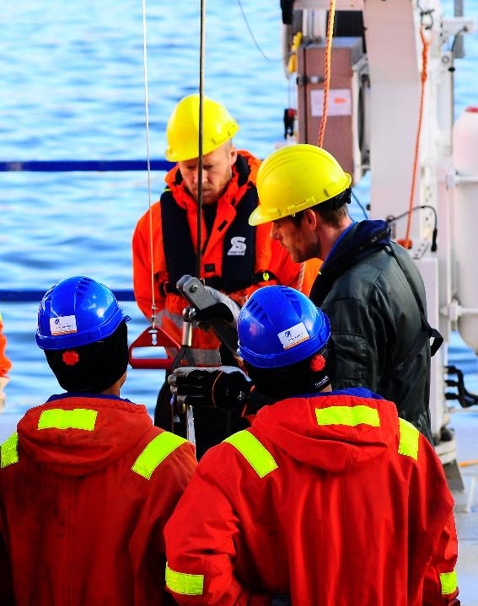
CONTINUOUS DEVELOPMENT AND OPTIMIZATION
HSQE Excellence
Ethical Business and Sustainability
Innovation and Change
Effective Human Resources
Training Ashore and Onboard
23

Slide 24
CONTINUOUS DEVELOPMENT AND OPTIMIZATION
HSQE Excellence
Do it right consistently, do it better continuously
All InterManager members continuously pursue operational excellence through strong commitment to maritime HSQE aspects.
Health, safety, quality and environmental protection are core principles of our business. They are the foundation to everything we do. Our decision making, actions and behaviours will adhere to these principles 100% of the time.
We have our own strict quality standards which comply with all applicable requirements determined by regulatory authorities, InterManager General Principles of Conduct & Action and our clients’ standards.
Our primary goal is to avoid causing any harm to people or the environment. We continuously strive to improve the quality and safety of our services.
We actively seek to minimize the environmental impact of our own operations and minimize or even eliminate hazardous emissions.
We recognize the importance of an effective security program to protect our personnel, assets, information, integrity and reputation from threats.
We mitigate risks by engaging in activities that focus on the core competencies of crisis management, prevention, preparedness, response and recovery.
Through our optimized integrated management systems we embed HSQE into our daily operations.
We don’t just comply, we take HSQE concerns to heart.

Slide 25
CONTINUOUS DEVELOPMENT AND OPTIMIZATION
HSQE Excellence
Expected Behaviours/KPIs
An Integrated Management System (IMS) is in place covering all HSQE relevant aspects/policies and industry’s requirements. IMS is optimized/simplified to maximize implementation, consistency and compliance.
01
Management commitment in HSQE excellence and IMS implementation is defined in vision/mission statements, policies and procedures.
02
HSQE and IMS improvement: Periodic Management Review committee meetings with KPIs and related improvement action plans.
03
HSQE performance is verified through benchmarking, internal and external audits.
04
05
IMS and HSQE training plan including CBTs and internal/external trainings is in place.
Governance: Internal/External Communications, accountabilities and responsibilities, organizational chart are available.
06
07
Fleet (navigation, cargo, engineering, mooring/anchoring, etc.) safety, management and maintenance related procedures are in place.

Slide 26
CONTINUOUS DEVELOPMENT AND OPTIMIZATION
HSQE Excellence
Expected Behaviours/KPIs
Procedures for the identification of potential hazards and shore-based management of operational risks (Risk Assessment, Permit to Work, Daily Work Plan, Mitigation Measures, Safety Inspections, etc.) are available.
08
An Environmental Protection Policy and management plan is in place. The environmental management plan includes energy efficiency, benchmarking, regulation compliance, fuel management, minimization of atmospheric emissions, evaluation of Company’s environmental impact, etc.).
09
A long-term “zero-emissions” environmental plan is maintained. The company explores new ideas and engages in technology partnerships related to environmental performance.
10
11
Emergency Preparedness, Business Continuity, Contingency Planning, Drills, Crisis Management and relevant facilities are available.
A structured process for conducting vessel inspections/audits to monitor, analyze and improve the standards/condition of vessels in the fleet is in place. Analysis of inspection results is compared with data from third party inspections.
12
Policies, procedures and training in order to respond and mitigate identified security threats covering all Company activities including cyber security are in place.
13
14
Data Protection procedure including general privacy principles for the processing and transfer of personal data. Data Protection Officer (DPO) is assigned.

Slide 27
CONTINUOUS DEVELOPMENT AND OPTIMIZATION
Ethical Business and Sustainability
Ethical and sustainable way of operating makes good business sense
All InterManager members responsibly manage our resources to positively benefit the society and our communities.
We take seriously our role as a responsible and ethical employers and economic contributors to our communities, providing well-paying jobs, contributing our share of local and state taxes, providing essential services for diverse customers and operating transparently.
Through systematic monitoring of the breadth and impact of our Ethics & Compliance plans we minimize the risk of noncompliance and increase ethical conduct within our Companies.
As integral parts of InterManager, we act sustainably to meet the needs of our customers in accordance with our collective responsibility for people, progress and the environment.
Our business decisions and actions demonstrate our commitment to the three pillars (financial, social and environmental) of long-term sustainability.
All InterManager members are committed to adopting clean technologies and gradually replace harmful substances with eco-friendly alternatives.
We adhere to InterManager’s General Principles of Conduct & Action and conduct ethical and sustainable operations through professionalism, respect for staff and stakeholders and a permanent concern for health, safety, quality and the protection of the environment.
Through honesty, responsibility, fairness, integrity, respect and care we succeed.

Slide 28
CONTINUOUS DEVELOPMENT AND OPTIMIZATION
Ethical Business and Sustainability
Expected Behaviours/KPIs
Ethics & Compliance are central to the Company’s Strategy. Code of Ethics and Conduct incorporates InterManager’s General Principles of Conduct & Action. Bribery and Anticorruption and Sustainability policies and procedures are in place. Code of Conduct is not simply rule-based, it is a cultural point of reference.
01
Vision, Mission, Purpose statements and core values give clear guidance relevant to what is considered right and what wrong in terms of the Company’s ethical culture. Ethical culture is led from the Top. Staff feels confident and are trained to raise concerns. Clients, third parties and all stakeholders are treated fairly and with transparency.
02
03
Disciplinary procedures describing levels of misconduct and related disciplinary actions.
Ethics and Compliance Plan build around 5 principles (E&C in Business Strategy, E&C Risk Management, Culture of Integrity, Speaking Up and Accountability).
04
Interdepartmental Human Factors & Organizational Culture Group (HFOG) monitors, evaluates and proposes actions for improving the Company’s Ethical & Compliance Maturity.
05
The Company communicates its Ethics and Compliance principles and learning internally though posters, circulars, forums, leadership communications, etc.
06
The Company shares its learning externally to positively influence other InterManager members and other Companies and toward ethical operation, responsible practices and a commitment to integrity.
07

Slide 29
CONTINUOUS DEVELOPMENT AND OPTIMIZATION
Ethical Business and Sustainability
Expected Behaviours/KPIs
A procedure is in place for internal and external response in case of serious misconduct harmful to the organization’s reputation. Appropriate disclosures are made to regulatory or other government authorities.
08
Misconduct/ethical history is considered for employee advancement, incentives, and awards.
09
The Company cooperates only with parties that it trusts. Third parties and suppliers are evaluated in terms of Ethics, Compliance to applicable laws/regulation, sustainability and social responsibility as applicable. Rejected third parties are communicated to InterManager.
10
11
11
Sustainability Report with environmental, social and governance (ESG) key metrics.
11

Slide 30
CONTINUOUS DEVELOPMENT AND OPTIMIZATION
Innovation and Change
Change is an opportunity, stagnation a threat
All InterManager members consider innovation and change as essential requirements for organizational success and growth and aim to go beyond a “Be more innovative” as an action towards change.
We acknowledge the need to balance day-to-day operational needs, comply with complex regulations, manage risks while also drive change and innovation in order to constantly adapt, evolve and create more safe and efficient operations.
Our leaderships promote the idea of change and innovation and commit to lead by example.
In our Companies an empowered culture of initiative, creativity and innovation is fostered: Our leaders encourage innovation, provide resources and reward relevant behaviours. Breakthroughs are celebrated.
We actively seek people that can innovate and develop a workplace friendly to change and novelty through strategies that evaluate and balance between short- and long-term benefits / effects.
Our long term planning philosophy incorporates quick wins, consolidation of best practices and adaptability at its core.
We facilitate an Innovative Mindset through training our people to tolerate ambiguity, have curiosity, affirmative judgement and remain persistent.
Persistence and Determination drives us.
Ambiguity and Complexity are motivators, not obstacles. We do not kill ideas, we encourage our people to find other ways to pitch them until we can see their value.
We embrace change and detest stagnation. We turn ideas into actions.

Slide 31
CONTINUOUS DEVELOPMENT AND OPTIMIZATION
Innovation and Change
Expected Behaviours/KPIs
A Change and Innovation policy that defines innovation and change and disseminates the Company’s development and adaptation strategy towards sustainable growth, transformation and competitiveness is available.
01
Management system, supported by appropriate staffing and procedures, to promote innovation and change especially towards energy efficiency, environmental protection and human factors development.
02
Procedures that facilitate the selection, appraisal and promotion of individuals with an Innovative Mindset are in place. Cross departmental familiarization is part of the main familiarization process.
03
Growth Mindset, Innovative Mindset and Leading Change trainings are available for Shore and Seagoing personnel.
04
05
Open Reporting System with suggestions for improvement where relevant feedback are welcomed ensuring confidentiality. No retaliation for ideas that bring change is ensured.
KPIs for the periodic adoption of suggestions for improvement and best practises are monitored.
06
07
Annual budget dedicated to innovation and change actions.

Slide 32
CONTINUOUS DEVELOPMENT AND OPTIMIZATION
Innovation and Change
Expected Behaviours/KPIs
Innovative idea generation is formally rewarded and recognized throughout the Company and fleet.
08
New approved ideas and best practices are implemented within a predefined time-frame.
09
10
Annual self-assessment and verification to adherence with InterManager’s General Principles of Conduct and Action.
Periodic assessment and verification to adherence with InterManager’s General Principles of Conduct and Action by a third-party assessor.
11
Identification of issues of non-compliance regarding InterManager’s General Principles of Conduct and Action set goals to address gaps and improve performance through an action plan with internal processes and a set of deadlines within a year of self-assessment.
12
Roadblocks to novelty, idea generation, change and best practice adoption are identified through periodic surveys, interviews, internal and external audits, etc.
13
14
Senior Officers are encouraged to participate and contribute in Office projects during leave.

Slide 33
CONTINUOUS DEVELOPMENT AND OPTIMIZATION
Effective Human Resources
Hire character, Train skill
All InterManager members understand that Human Resources management is one of the most important and most dynamic assets in our organizations.
We consider as priorities the motivation of our workforce, competitive remuneration, adequate training and management development programmes. Provision of optimal working conditions are paramount for us because we care for our people.
We emphasize on selecting our people based on character, cultural fit and skill and seek to operate over and above the required labour and employment legislation.
Professional competency consists of both Technical and Behavioural competency and we constantly seek to hire, appraise, develop, promote and reward people on both facets.
Errors are perceived as genuine human mistakes, our leaders are the first to accept their shortcomings, we don’t seek to punish. We constantly seek to identify, appreciate and reward our staff.
We promote a healthy and effective workplace through realistic and measurable targets, safety standards, work-life balance, emotional and physical security, talent management and opportunities for growth.
A bidirectional communication is encouraged and continuously facilitated. Frontline employees actively contribute and participate in improving our culture.
We are transparent in our public communication, discrete in private and constantly seek to align the work with our Company’s goals.
When people are emotionally invested, they want to contribute.

Slide 34
CONTINUOUS DEVELOPMENT AND OPTIMIZATION
Effective Human Resources
Expected Behaviours/KPIs
01
Human resources guidelines (Dos and Don’ts) regarding the approach the Company utilizes to manage its people.
Crew and Human Resources procedures consisting of hiring, familiarization, appraisal, promotion, training requirements, personnel development, etc.
02
03
Hiring procedure with systematic evaluation of Technical and Behavioural Competencies consisting of relevant predefined competency criteria frameworks.
Ethical Guidelines / Policy Acceptance signed by all.
04
05
Work-life balance is promoted and protected through procedures, policies and leading by example.
Employee relations procedures include among others, talent management, teleworking, motivation, employee support, misconduct, extra-curricular initiatives, higher education as applicable for shore and seagoing personnel.
06
Human Factors Committee which periodically evaluates Company’s culture, ethics, personnel satisfaction, wellbeing, performance issues, related policies and decides on improvement actions and plans.
07

Slide 35
CONTINUOUS DEVELOPMENT AND OPTIMIZATION
Effective Human Resources
Expected Behaviours/KPIs
Actions to establish a well-defined culture onboard and ashore are evident (surveys, campaigns, visits/meetings’ agenda, lead by example, etc).
08
Volunteering, engagement with the community and social activities are actively promoted.
09
10
The appraisal process is essential and consists of departmental, contract and personalized targets/KPIs. Appraisers are evaluated for the quality of their evaluations.
Human Resources KPIs beyond the monitoring of retention rates and may include metrics such as Job Satisfaction, Trust towards Management, Average Appraisal Scores, etc.
11
Systematic attraction, identification, development, engagement, retention, and deployment of those individuals who are of particular value to the Company is achieved through efficient talent management.
12
A formal reward scheme comprising of the monetary, non-monetary and psychological incentives provided to personnel exists. The scheme is linked to specific performance indicators.
13
Benchmarking is utilized to compare the Company’s Human Resources management performance against top performers within InterManager/Industry and develop an optimal roadmap of initiatives.
14

Slide 36
CONTINUOUS DEVELOPMENT AND OPTIMIZATION
Training Ashore and Onboard
It’s not the Ship, it’s the Competence
All InterManager members acknowledge that proper quantity, quality and variety of training ashore and onboard are the cornerstones of safe and efficient vessel operation.
Our aim is to promote an inclusive working culture through training and mentoring to support open communications and improve morale and working relationships ashore and onboard.
Continual professional development of personnel is actively encouraged and supported within our Companies.
We understand that proper training gives everyone a great understanding of their responsibilities and the knowledge and skills they need to perform their duties. This enhances their confidence which improves overall safety awareness and overall performance.
Furthermore, we are aware that personnel in Shipping work in highly risk environments, where Human Factors and personnel Technical & Behavioural competencies play a key role in performance at both individual and organizational level.
Thus, Human Factors, Human Error and Technical and Behavioural Competencies are integral parts of our training planning.
Our training and mentoring programmes for job competencies, maximize learning through peer-to-peer knowledge exchange.
We focus on building strong theoretical foundations.
We consolidate competence through hands-on practical implementation.

Slide 37
CONTINUOUS DEVELOPMENT AND OPTIMIZATION
Training Ashore and Onboard
Expected Behaviours/KPIs
Code of Conduct including commitment to promote an inclusive working culture through training and mentoring to support open communications and improve morale, working relationships and peer-to-peer knowledge sharing onboard and ashore.
01
A dedicated budget for Shore and Seagoing personnel for promoting higher education and advanced training is available on an annual basis.
02
A training Program (in line with Industry standards i.e., ISM Code, SOLAS, MARPOL, STCW, MLC 2006 etc.) which includes minimum training required for key positions ashore and onboard, including job specific HSSE training, is available.
03
Computer-based training (CBTs) onboard are available.
04
05
A Competence Management System, including Technical (Navigation, Mooring & Anchoring, Cargo, Engine) and BCAV training is in place.
An established process for measuring the value and effectiveness of the training provided is available.
06
07
HSQE training is consistent globally and verified during Internal Audit process. Relevant KPIs are monitored.

Slide 38
CONTINUOUS DEVELOPMENT AND OPTIMIZATION
Training Ashore and Onboard
Expected Behaviours/KPIs
Training in the maritime industry, job skills, languages, business technology, leadership/management, finance, and similar topics at various levels is offered in partnership with academic/training institutions or own programs.
08
A formal cadet training program to ensure that future manning needs can be met is in place.
09
10
A process for deck Officers to receive ship-handling training prior to promotion to Master exists.
Cooperation with (or a dedicated) training centre with practical training including simulator is available.
11
12
Continual professional development of personnel is encouraged and supported.

Slide 39
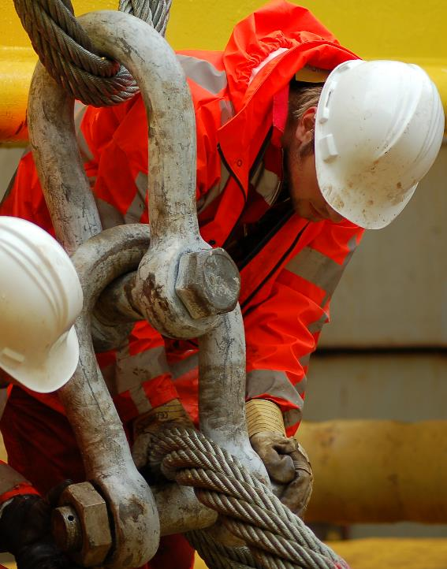
EFFECTIVE SAFETY CULTURE
Visible Safety Leadership
Corporate Commitment to Safety
Human Factors Management
Safety Performance Improvement
Sharing of Lessons Learnt / Proactivity
39

Slide 40
EFFECTIVE SAFETY CULTURE
Visible Safety Leadership
Our dedication to Safety is unconditional
All InterManager members understand that leadership commitment to safety is the core component of an effective safety management system.
Safety is our core value, an undisputed first priority. We frequently communicate key aspects of our safety policy, principles and vision.
Our commitment to safety does not change with commercial pressure and is integrated into all significant and relevant business decisions.
Our leaderships visibly demonstrate their commitment to continuous improvement in safety culture and safety performance.
We continuously strive to develop an environment of trust through consistent communications and consultation with all staff.
We actively conduct regular safety conversations, lead safety meetings, enforce standards and are willing to allocate any necessary resources for safety initiatives.
Two-way communication with the frontline employees is prioritized. We learn from those who do the job.
Our leaderships are personally involved in incident investigations to gain insights while ensuring impartiality, no-blame and freedom to report and enhance due diligence.
Our long term planning philosophy aims at promoting continuous improvement in the safety journey.
We recognise that the journey to safety excellence either starts at the top or doesn’t start at all.

Slide 41
EFFECTIVE SAFETY CULTURE
Visible Safety Leadership
Expected Behaviours/KPIs
Safety Leadership statement from the Top Management that highlights the belief that all injuries are preventable and demonstrates genuine care for all personnel.
01
Leaders act to promote Safety: They shape Safety Culture through actions, commitment, leading by example, ensuring appropriate resources and compliance to processes.
02
Leaders demonstrate due diligence regarding Safety: They are personally involved to gather information, understand and gain knowledge to share first-hand regarding Safety.
03
Annual message from the Top Management that goes beyond basic compliance and connects personal and professional purpose to the top objectives of the Company including Safety.
04
An annual plan is presented from the Top Management to address the following question: What strategies will you implement to ensure your actions as a Leader are helping, not hindering, your safety efforts?
05
Periodic physical and virtual Management vessel visits with agenda.
06
07
Periodic physical and virtual Top Management vessel visits with agenda.

Slide 42
EFFECTIVE SAFETY CULTURE
Visible Safety Leadership
Expected Behaviours/KPIs
Mentors onshore and onboard are identified based on their capacity to promote Safety Culture.
08
Safety Leadership capacity is an integral part of the selection, appraisal and promotion processes.
09
10
Reward plan is in place for Safety Leadership exemplary performance.
Safety leadership training/workshops for onshore and onboard leaders.
11
12
Annual forum where leaders from all levels have the opportunity to be visible and closely interact with each other and frontline personnel.
A process for bottom-up, consultative approach that ensures open dialogue between personnel and leadership and reduces the relational distance between different levels of the organisation and contributes to a positive safety culture by promoting trust is in place.
13
14
Periodic surveys to all personnel monitor levels of trust and commitment to onshore and onboard leadership.

Slide 43
EFFECTIVE SAFETY CULTURE
Corporate Commitment to Safety
When it comes to Safety, we walk the walk
All InterManager members acknowledge that trend chasing is not enough, only long term strategies succeed.
We know that creating a strong culture of safety in the workplace can be complicated and difficult. It requires a comprehensive approach that involves continuous improvement.
However, we are strongly committed and personally devoted to empower our workforce to become self-accountable for injury prevention and actively care for the safety and health of others.
We are willing to listen to both good and bad news and thus facilitate the capacity of our people to report.
Our leaders are enthusiastic and passionate, and show care, respect and appreciation for all staff. We are constantly searching for ways to reward and support desirable acts through emotion, empathy and empowerment.
We are not failure-focused, we focus also on positive accomplishments, like safety hazards removed, near-misses reports submitted and reviewed or safety audits completed.
Personnel participation in our safety processes is the key to preventing injuries. Everyone in our organizations is involved in monitoring and improving Safety and we actively seek people that can make a difference.
Safety is a condition of employment and all personnel are responsible for Safety and for preventing injuries.
Safety practices need to be meaningful, not mechanical.

Slide 44
EFFECTIVE SAFETY CULTURE
Corporate Commitment to Safety
Expected Behaviours/KPIs
01
Safety is a core value and an integral part of the Company’s Vision, Mission, Purpose statements and policies.
Management system, supported by appropriate staffing and procedures, to promote Safety Culture, practices, Leadership’s commitment and involvement/compliance of all personnel in Safety.
02
03
Rather than looking to blame, leaders commit to learn about Safety through feedback on systems, conditions and tasks.
Job descriptions with minimum requirements, objectives and accountabilities relevant to Safety are evident.
04
A process to report barriers for reporting is in place: Conditions that trigger reporting are identified and clarified. Reporting is formalized and facilitates learning and improvement in regard to Safety.
05
Safety critical tasks are defined. Appropriate training and mitigation measures are in place to control risk and hazards.
06
07
Safety Committee identifies and addresses safety concerns suggestions.

Slide 45
EFFECTIVE SAFETY CULTURE
Corporate Commitment to Safety
Expected Behaviours/KPIs
Company’s leaders participate in industry’s forums to share and gain knowledge regarding the latest Safety related trends.
08
Training for onshore and onboard personnel to build the situational awareness that allows them to focus on specific actions and move toward value-based consequences.
09
Periodic communication/campaigns aiming to educate personnel regarding latest advancement in Safety are evident.
10
Promotion of Ethics training to help onshore and onboard personnel recognize circumstances in which their own actions could harm others, the environment and tarnish the Company's reputation.
11
11
11
Leadership actively engages with the workforce at all levels, sharing values, expectations, information, listening and acting on feedback and concerns regarding Safety.
12
12
13
Zero accidents goal
14

Slide 46
EFFECTIVE SAFETY CULTURE
Human Factors Management
Our people are the solution, not the problem
All InterManager members know that Human Factors are an integral part of our strategy and a key enabler to further reduce safety, environment, security and health negative impacts within our organizations.
We unconditionally accept that:
Error is normal. Even the best people make mistakes.
Blame fixes nothing.
Learning and improving is vital. Learning is deliberate.
Context influences behavior. Systems drive outcomes.
How we act and respond to failure matters.
We comprehend that Human Error is impossible to eliminate and thus we focus to minimize it via seeking to applying best practices and promoting an Error Minimization Culture.
Reliable human performance is facilitated within our Companies by offering optimal working conditions to minimize error and decrease the risk for human failure.
We constantly strive to understand why our people do what they do and what drives their actions. This drives our risk management and focus our efforts and resources on the most significant lessons learnt and risks we identify.
To materially reduce risk to our personnel, third parties, environment and assets we:
Lead and shape our cultures.
Promote well executed tasks and procedures.
Provide well designed equipment and controls.
Build capacity and skills of our personnel to respond to emerging situations.
We learn before and after things go wrong.
We daily assess and determine the safer and most effective way to operate.

Slide 47
EFFECTIVE SAFETY CULTURE
Human Factors Management
Expected Behaviours/KPIs
01
Company policy on Human Factors along with a commitment that the company plans to implement this policy.
Company’s Core Values/Vision/Mission are enhanced to include Human Factors and human performance related elements.
02
03
Human Factors, Safety Culture and Organizational Culture Concepts are defined within the Safety Management System.
Human Factors representatives onboard.
04
05
Methods, tools and training (Human Factors, Error Typology, etc.) to assess the underlying conditions that shape human performance in safety-critical tasks.
Behavioural Based Safety procedure and training.
06
07
Error Risk Management, Job Hazard Analysis, Error Risk Minimization, Task Risk Assessment (TRA) procedures are in place.

Slide 48
EFFECTIVE SAFETY CULTURE
Human Factors Management
Expected Behaviours/KPIs
Human Factors Development role to be responsible for understanding and implementing Human Factors is established. Relevant accountabilities, objectives and minimum requirements are in place.
08
Interdepartmental Human Factors & Organizational Culture Group (HFOG) to support the Human Factors Development role is established. Evidence of periodic meeting minutes, action plans and follow up are available.
09
10
Performance Influencing Factors (PIFs) are defined and monitored.
Periodic Independent Human Factors Audits.
11
12
Incident investigators’ competence in Human Factors is build. The independence of investigators’ recommendations from Company management is evident.
Benchmarking is utilized to compare the Company’s Human Factors management performance against top performers within InterManager/Industry and develop an optimal roadmap of initiatives.
13

Slide 49
EFFECTIVE SAFETY CULTURE
Safety Performance Improvement
We focus on commitment, not compliance
All InterManager members understand that Safety cannot be consistently improved without specific, data-based feedback.
We acknowledge that data must be carefully selected to identify, not just accidents and other negative events, but also accomplishments.
We are skeptical of opinions and recommendations, even if they make sense, we always back them up with data that can be used to target specific Safety Aspects and facilitate continuous improvement.
We align our Safety improvement approach with our vision and are careful to integrate Safety improvement approaches into one integrated system that allows employees to speak one language.
We develop well-trained incident investigation teams that understand that real and accurate findings which will eventually help our organizations solve the real problem.
We refrain from being overly strict and create fear on our people for unsafe acts. We focus on recognizing and rewarding them for their contribution to Safety.
We acknowledge that complacency is the most dangerous form of hazard. We promote new techniques on how to be safe at work and remind our people of their role in safety with refresher training.
Our goal is to constantly improve and not just maintain the status quo.
We make sure our people know what happens when they do the right thing and ensure that they know what happens when they don’t.

Slide 50
EFFECTIVE SAFETY CULTURE
Safety Performance Improvement
Expected Behaviours/KPIs
Safety Culture KPIs are defined and reviewed periodically. Relevant improvement actions plan tackle subpar performance and facilitate improvement.
01
Safety related best practices are identified, rewarded and promoted within the Company as well as, to the other InterManager members and the industry.
02
Benchmarking is utilized to compare the Company’s Safety Culture improvement against top performers within InterManager/Industry and develop an optimal roadmap of initiatives.
03
Company’s leaders are willing to act as ”Mentors” to other InterManager members to promote Safety within the association. They are equally willing to receive mentoring form others.
04
05
Training plan for onshore and onboard personnel to build capacity to respond effectively in challenging situations.
Recognition and reward plan for employees’ contribution to Safety.
06
07
The Company uses scenario-based exercises to assesses the effectiveness of training for safety-critical activities.

Slide 51
EFFECTIVE SAFETY CULTURE
Sharing of Lessons Learnt / Proactivity
Knowledge doesn’t matter unless it is shared
All InterManager members acknowledge that knowledge management is one of the most crucial aspects of business progress.
Without access to knowledge employees and organizations suffer and thus facilitation of knowledge sharing within and between our Companies is a priority.
We are committed to facilitate a knowledge sharing culture aiming to increase effectiveness, expertise, proactivity, social interaction and trust among us. To enhance our Corporate Memory, we enrich our knowledge bank so everyone is able to access it.
We intend to be systematic and methodical in developing knowledge sharing systems where, through leading by example, knowledge is passed from senior and more experienced employees to juniors and newcomers.
Unity is strength and all members commit to participate in our annual forums, regular virtual conferences, periodic campaigns to communicate best practices and lessons learnt, promote safety and discuss ideas. More experienced members commit to pass knowledge to junior, newcomer and candidate members.
Together we are progressing collectively from blame to learning culture, we become learning organizations and we consider error as an opportunity to develop, succeed and act proactively.
InterManager, is dedicated to provide continuous mentoring to all members regardless of their status in order to ensure that they steadily progress and succeed.
We gain power by sharing knowledge, not by hoarding it.

Slide 52
EFFECTIVE SAFETY CULTURE
Sharing of Lessons Learnt / Proactivity
Expected Behaviours/KPIs
Code of Conduct defines knowledge management and corporate memory as a set of proactive activities with the aim of supporting the organization and in developing, integrating, disseminating and implementing its knowledge.
01
Integrated Management system, with a continuous process to understand the organization's need for knowledge, the location of knowledge, as well as the process for improving knowledge. The goal is to increase the organization's ability to perform its key processes effectively through a knowledge management system.
02
03
A no-blame culture and facilitation of knowledge policy is in place. Error is defined as an opportunity, a step towards process and part of being successful.
A mentoring scheme is available for newcomers and for personnel near promotion.
04
Actions that facilitate corporate memory are in place. Lessons learnt from incidents, accidents and near misses are part of the familiarization process, CBTs, campaigns, trainings, meetings and annuals forums.
05
The Company participates in InterManager’s annual forums. Lessons learnt from incidents, accidents and near misses as well as best practices and ideas are shared with the other members and discussed periodically.
06
The Company is willing to act as a “mentor” to candidate members, members in probationary status and members in need of further development in order to help them improve.
07

Slide 53
EFFECTIVE SAFETY CULTURE
Sharing of Lessons Learnt / Proactivity
Expected Behaviours/KPIs
The Company is willing to seek and accept support from InterManager and other members in order to facilitate its practical implementation of the Code of Conduct, develop and improve.
08
A “Risk Management System” is in place that monitors various leading indicators and leads to proactive action plans.
09
Periodic campaigns aiming to educate personnel regarding latest advancement in shipping are evident.
10
Progress regarding adherence to InterManager’s Code of Conduct is shared with the rest of the members. Roadblocks, best practices, achievements and failures are openly discussed.
11
11
11
12

Slide 54
ASSESSMENT AND VERIFICATION
54

Slide 55
Assessment and Verification Scope
We pursue excellence by attitude, We operate efficiently by habit
To ensure a basic standard of adherence to its General Principles of Conduct and Action, InterManager provides assessment and verification to its members, annually or upon request.
The process’ scope is to assess and verify that applicable elements of InterManager’s General Principles of Conduct and Action are appropriate, effective and that have been developed, documented and implemented in accordance and in conjunction with the Association’s specified requirements and prerequisites.
To ensure transparency and objectivity, the assessment and verification process relies on the examination and evaluation of objective evidence based on the General Principles of Conduct and Action set KPIs, requirements and expected behaviors.
The whole process is oriented towards a qualification / progress assessment rather than constitute an absolute “pass/fail” evaluation.
Members and candidates are expected to progress through a 4A Success Path - Aspire, Advance, Achieve and finally Acclaim in regard to the Association’s General Principles of Conduct and Action.
They are also expected to contribute and cooperate during the assessment and verification cycle by showing diligence and transparency.
InterManager will provide all the necessary support and guidance to assist Members and candidates succeeding in achieving and sustaining their optimal level of adherence to its General Principles of Conduct and Action.

Slide 56
Assessment and Verification Process
We pursue excellence by attitude, We operate efficiently by habit
All members of InterManger (Full and Associate) agree to submit to periodic assessment and verification as to their adherence with InterManager’s General Principles of Conduct and Action.
Such assessment shall be both by way of annual self-assessment and periodic assessment by an independent third-party assessor which shall assess and advise the relevant Member on its status. The presumption is that all existing members adhere or aspire to InterManager’s General Principles of Conduct and Action.
Such independent assessment shall be a pre-requisite for any newly joining member within a year of joining and shall be a condition for permanent membership.
The results of any assessment will be kept confidential to the Assessing Organisation and only referred to InterManager’s Executive Committee where serious concerns exist as to the target Member’s commitment to InterManager’s General Principles of Conduct and Action.
In agreeing to third-party assessment, InterManager Members underline their absolute commitment to maintaining the highest professional and ethical standards in the conduct of their business and trust that InterManager membership will be seen by international community as a badge of excellence and quality which can be relied upon in professional dealings.

Slide 57
Assessment and Verification 4A Success Path
I.
II.
III.
IV.
Aspire
Advance
Achieve
Acclaim
Build motivation
Develop strategy
Commit to goal
Pursue abidance
Identify gaps
Embrace challenges
Adapt
Monitor progress
Consolidate practice
Refine processes
Create leverage
Optimize output
Continuous learning
Constant improvement
Exemplary performance
Highest standards
Strong reputation

Slide 58
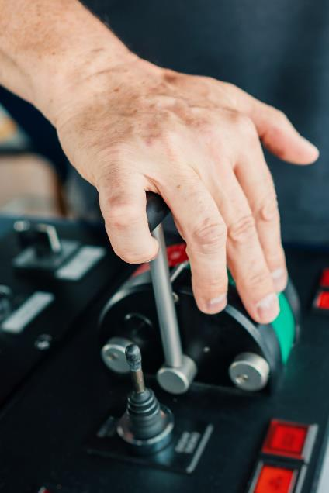
ANNUAL
SELF ASSESSMENT AND IMPROVEMENT CYCLE
58

Slide 59
Annual Self Assessment and Improvement Cycle
Identify gaps
Locate best practices
Evaluate annual progress towards previous annual target set
Build rapport with Executive Committee
Discuss, agree and set annual improvement objectives
Evaluate Adherence
Improvement Action Plan
01
03
02
04
Annual Self Assessment
Reporting
Review documentation
Assess implementation
Evaluate Cultural aspects
Review Industry trends
Submit confidential annual report to Executive Committee
Analyze risk and opportunities Propose improvement action plan
InterManager
Member

Slide 60
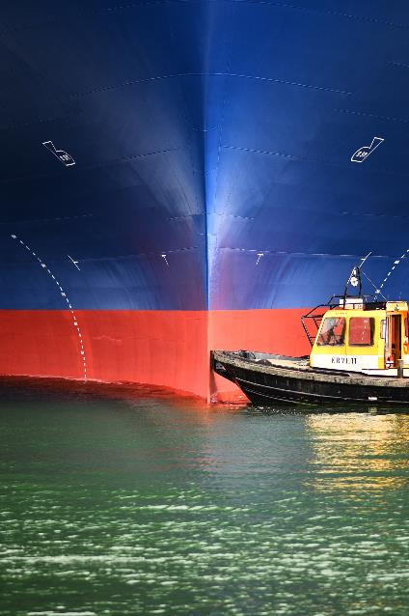
PERIODIC THIRD PARTY ASSESSMENT AND VERIFICATION
60

Slide 61
Periodic Third Party Assessment and Verification
Build rapport with Candidate/Member
Elaborate on adherence status
Discuss, agree and set annual improvement objectives with Candidate / Member
Send assessment notification letter
Gather background information
Create assessment program
Agree program with Candidate / Member
Analyze findings
Evaluate Candidate / Member’s annual progress
and/or verify adherence status
Propose improvement action plan
Review documentation
Assess implementation process
Evaluate cultural aspects
Assessment Preparation
Fieldwork
Reporting
Verification
02
04
06
01
03
05
07
Report Submission
Initial Meeting
Exit Meeting
Discuss planned assessment with Candidate / Member
Solicit input
Explain timing
Discuss assessment’s conclusion / debriefing
Resolve questions / concerns and adherence issues
Communicate easy wins
Submit confidential report and propose improvement action plan to Executive Committee
InterManager
Alpha Marine Consulting P.C.

Slide 62
Assessment Preparation
Send assessment notification letter
Gather background information
Create assessment program
Agree program with Company
Explain objectives
State expected duration
Explain process, timetable and conclusion phase
Ask transparency and cooperation
Review Candidate / Member’s previous improvement action plan objectives (if any)
Gather Candidate / Member specific information
Compile preliminary survey / questionnaire
Compile list of items / documentation necessary for the assessment
Select assessment tools and techniques to be used
Decide which Candidate/Member’s personnel to be involved
Discuss assessment program with Candidate / Member
Evaluate requests, obstacles and context / timing specific details
Finalize assessment program

Slide 63
Initial Meeting
Discuss planned assessment with Member
Solicit input
Explain timing
Build rapport with Candidate / Member
Discuss scope / objectives
Answer questions
Address concerns
Evaluate GDPR issues
Ensure alignment with Candidate / Member’s objectives
Identify barriers / skepticism
Detect opportunities
Highlight safety issues
Assess cultural risks
Prioritize minimum interference with Candidate / Member’s operations
Highlight deadlines
Explain assessment’s adaptability to risks and opportunities

Slide 64
Fieldwork
Assess implementation process
Review documentation
Evaluate cultural aspects
Review set KPIs, requirements and expected behaviors
Perform relevant gap-analysis
Record documentation-related evidence
Check relevant records
Observe and evaluate processes
Obtain relevant information through questioning
Record implementation related evidence
Administer cultural assessment survey
Gather cultural related information through systematic observation
Conduct semi-structured interviews

Slide 65
Exit Meeting
Discuss assessment’s conclusion / Debriefing
Resolve questions / concerns and adherence issues
Communicate easy wins
Present assessment’s process / implementation
Highlight on lessons learnt obtained
Elaborate on leadership’s commitment during the process
Elaborate on questions
Listen to objections / concerns
Build consensus on challenges and opportunities encountered
Promote immediate improvement following the assessment’s conclusion
Present impactful and easily implemented improvement actions
Offer any necessary practical advice

Slide 66
Reporting
Evaluate Candidate / Member’s annual progress and verify adherence
Propose improvement action plan
Analyze findings
Describe materials and methods
Categorize observations and findings
Organize quantifiable data
Compare and contrast performance in relation to set objectives and targets (where applicable)
Evaluate rate of progress
Identify key performance facilitators and barriers
Identify strong points and points for improvement
Propose targeted performance improvement action plan
Propose plan’s timetable

Slide 67
Report Submission
Propose improvement action plan to Executive Committee
Submit confidential report to Executive Committee
Secure delivery of confidential information
Safeguard trusted information
Handle sensitive findings with caution
Present and discuss proposed improvement action plan
Suggest strategic course of action

Slide 68
Verification
Discuss, agree and set annual improvement objectives with Candidate / Member
Build rapport with Candidate / Member
Ensure alignment between the Association’s and Candidate / Member’s objectives
Evaluate requests, obstacles, context and timing specific details
Handle sensitive findings with caution
Present and discuss proposed improvement action plan
Agree on strategic course of action
Highlight Association's expectations
Commit to provide any necessary assistance

Slide 69
Continuous Performance Improvement Monitoring
Verification Visits
InterManager Benchmarking
Open Reporting System
Continuous Learning
Intensive Monitoring Status
Standardized virtual / physical visits onboard
Safety culture monitoring
Organizational Cultural elements evaluation
Training levels assessment
Benchmarking on selected fundamental KPIs
Coordinated Members’ improvement
Performance Infuencing Factors (PIF) monitoring tool
Open reporting hotline
Confidential 24/7 helpline
Ensured anonymity
Guaranteed non-retaliation
Annual forums
Regular webinars
Communication among Members of best practices / lessons learnt
Periodic Campaigns
Close support to Candidate / Members
Probationary status for serious / continuous subpar performance
Continuous mentoring / guidance to Members pursuing excellence
69
InterManager
Alpha Marine Consulting P.C.

Slide 70
CONCLUSION
Ship Management Industry, such as Ship Management and Crew Managers and their associate partners, with integrity and ethos aim at bringing strong positive impact worldwide.
InterManager’s General Principles of Conduct and Action sets the collective principles that all Members should follow and is regarded as vital to their success towards reaching the highest standards of ship operations.
The General Principles of Conduct and Action do not intend to replace Members’ consistency to their Culture and Values. It rather aim to facilitate a “mental and cultural” alignment among them through the sharing of common values and aspirations so that they stand out in reputation and integrity in Ship Management and help them achieve progress towards the best / highest standard of Ship / Crew Management.
InterManager is able to instil, as the leading Association and by attracting the most successful Companies, high business standards, social responsibility and operational excellence across the Shipping Industry.
70

Slide 71
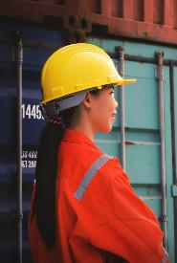
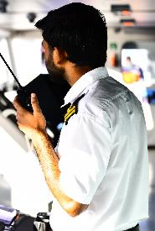
DEDICATED TO SHIP AND CREW MANAGEMENT

Slide 72
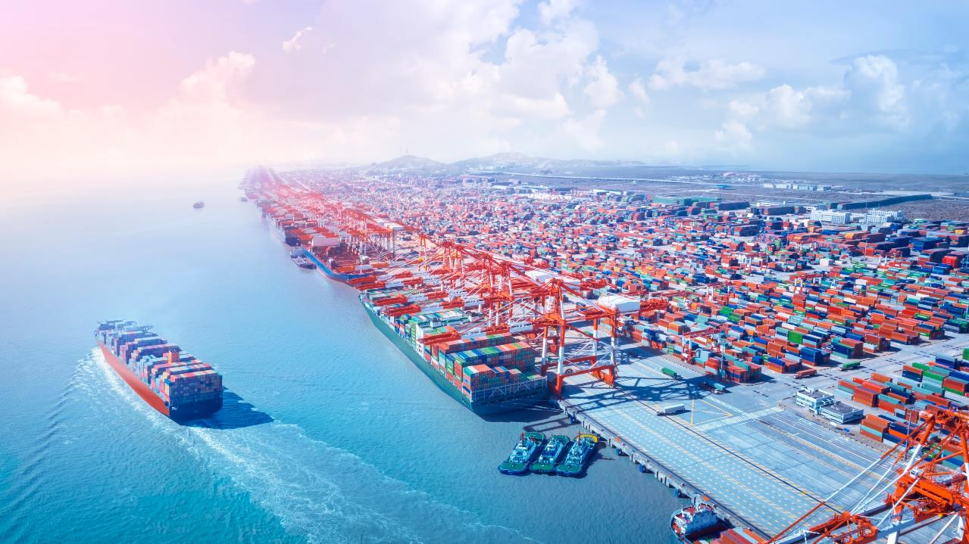
hdhhd
General Principles of Conduct and Action
In collaboration
with

